Slide 1
EPPO and EU Law
(Jean Monnet Centre of Excellence - STEPPO)

Slide 2
EPPO structure
LECTURER: Ilaria Sticchi

Slide 3
EPPO infographic

Slide 4
EPPO infographic
Article 8 EPPO Regulation
(1) The EPPO is an indivisible Union body operating as a single office with a decentralised structure. | Statement of the constituent principles governing the bodies
(2) The EPPO is organised at central and decentralised level. | Internal governance of the EPPO
(3) The central level shall consist of a Central Office at the seat of the EPPO. The Central Office shall consist of the College, the Permanent Chambers, the European Chief Prosecutor, the European Deputy Chief Prosecutors, the European Prosecutors and the Administrative Director. | Designation of actors at central level
(4) The decentralised level shall consist of European Delegated Prosecutors located in the Member States. | The decentralised level
(5) The Central Office and the European Delegated Prosecutors shall be assisted by the staff of the EPPO in their duties under this Regulation. | The staff of the EPPO

Slide 5
Central office / Decentralised office
The central level of the EPPO, located in Luxembourg, is composed of:
the European Chief Prosecutor;
22 European Prosecutors (one from each participating EU MS), two of whom act as Deputy European Chief Prosecutors;
and the Administrative Director.
College of the EPPO: European Chief Prosecutor and the 22 European Prosecutors.
The European Prosecutors and the Administrative Director are assisted in their work by a range of experts in areas including administrative, technical, operational and legal support.
The decentralised level of the EPPO shall consist of:
the European Delegated Prosecutors (EDPs) in the 22 participating EU Member States.
Offices in the participating Member States.
The central level supervises investigations and prosecutions conducted by EDPs at national level, which operate in complete independence from their national authorities.

Slide 6
College of the EPPO
Article 9 EPPO Regulation
(1) The College of the EPPO shall consist of the European Chief Prosecutor and one European Prosecutor per Member State. The European Chief Prosecutor chairs the meetings of the College and is responsible for their preparation (+ Recital 25) | composition
(2) The College shall meet regularly and shall be responsible for the general oversight of the activities of the EPPO. It shall take decisions on strategic matters, and on general issues arising from individual cases, in particular with a view to ensuring coherence, efficiency and consistency in the prosecution policy of the EPPO throughout the Member States, as well on other matters as specified in this Regulation. The College shall not take operational decisions in individual cases. The internal rules of procedure of the EPPO shall lay down the arrangements for the exercise of general control activities and for taking decisions on strategic and general matters | functions/tasks
(3) On a proposal by the European Chief Prosecutor and following the internal rules of procedure of the EPPO, the College shall set up Permanent Chambers. (4) The College shall adopt the internal rules of procedure of the EPPO in accordance with Article 21 and establish the responsibilities for the performance of the duties of the members of the College and of the staff of the EPPO | Internal organisational structure
(5) Unless otherwise stated in this Regulation, the College shall take decisions by simple majority. Any member of the College shall have the right to initiate voting on matters to be decided by the College. Each Member of the College shall have one vote. The European Chief Prosecutor shall have a casting vote in the event of a tie vote on any matter to be decided by the College. | Exercise of the vote
Internal Rules of Procedure (Articles 4-14bis) | The College

Slide 7
College of the EPPO - Infographic

Slide 8
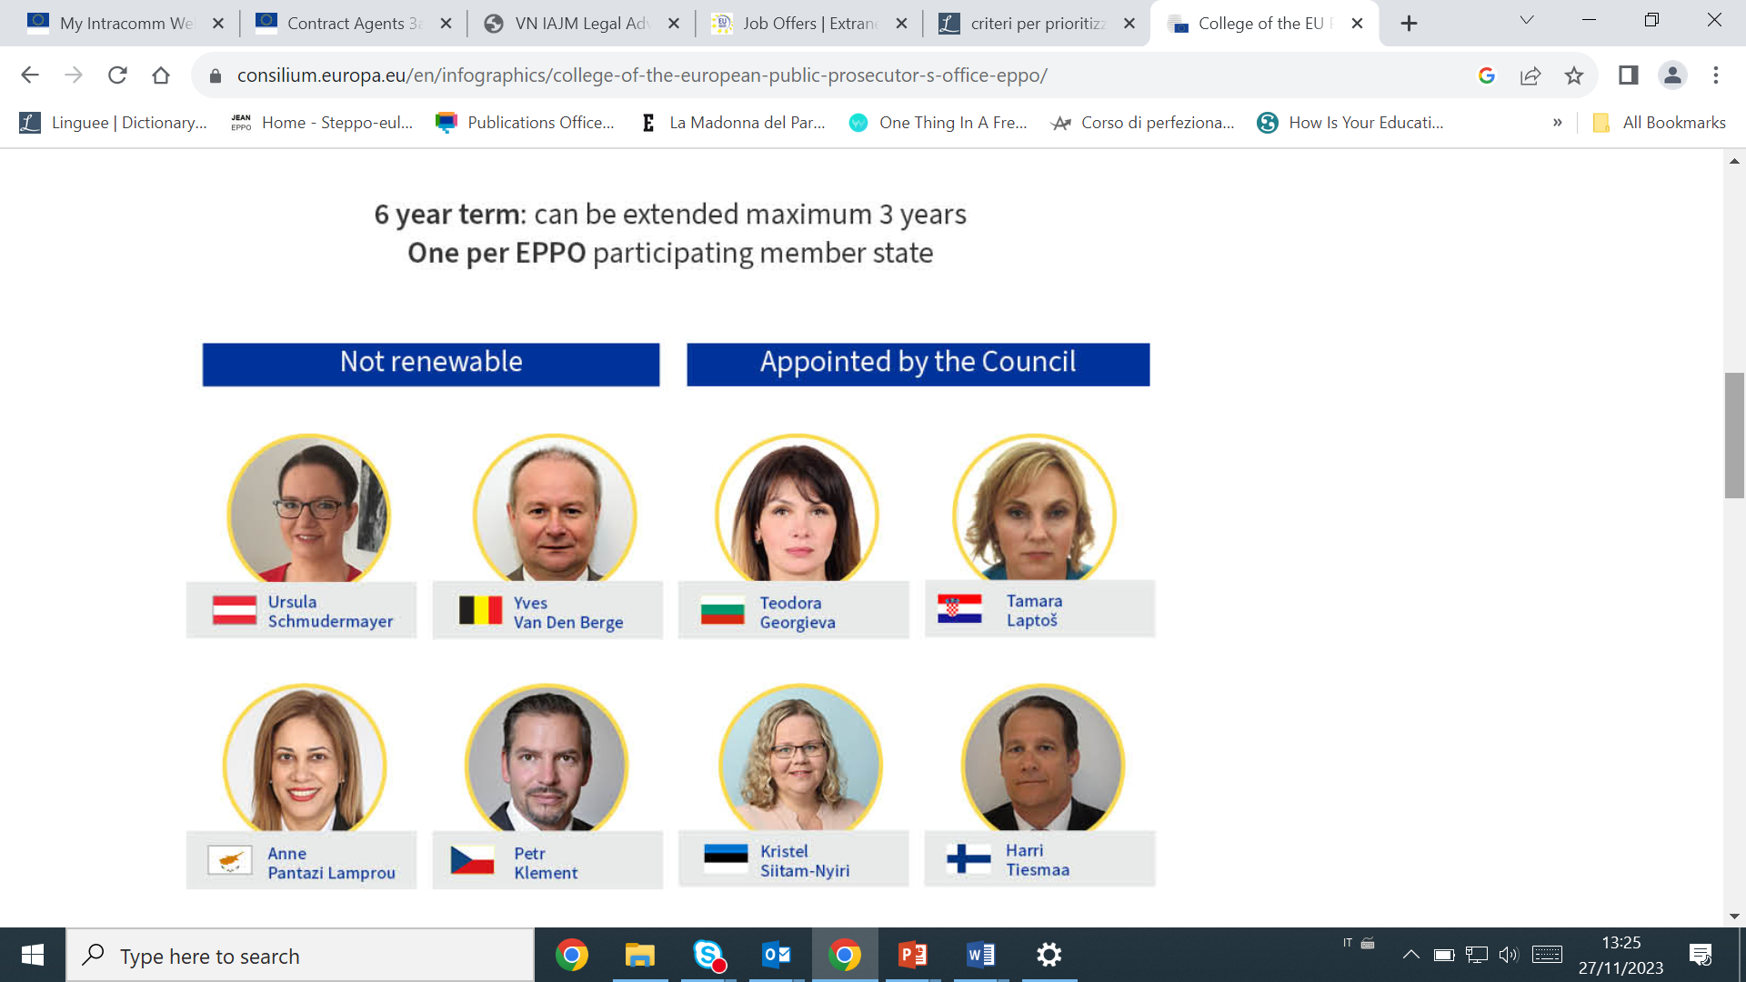
College of the EPPO

Slide 9
College of the EPPO – functions and tasks
The College of the EPPO is responsible for the general oversight of its activities, for taking decisions on strategic matters, and for general issues arising from individual cases, in particular with a view to ensuring coherence, efficiency and consistency in the prosecution policy of the EPPO throughout the participating Member States.
No operational decisions on cases
Adopt the estimated budget of the EPPO and the budget of the EPPO in accordance with Article 92(2) and, respectively, Article 92(7) of the EPPO Regulation; adopt the decisions referred to in Articles 98 (Seconded National Experts and other staff), 107 (2) (EPPO’s internal language regime), 109 (2) (access to documents), 114 of the EPPO Regulation (anti-fraud strategy, annual and multiannual programming document, conditions of employment); adopts guidelines (Guidelines*) pursuant to Article 9(2) of the EPPO Regulation, as provided for in Articles 25 (2) (EPPO competence for a criminal offence where they damage the Union’s financial interests below EUR 10 000), 27 (8) (an offence causing or likely to cause damage to the Union’s financial interests of less than EUR 100 000), 34 (3) (competence of national authorities in cases where a criminal offence causing or likely to cause damage to the Union’s financial interests of less than EUR 100 000, and 40 (2) (Permanent Chamber adopts a decision on the proposal of the handling European Delegated Prosecutor taking into account the following reasons: (a) the seriousness of the offence, on the basis, in particular, of the damage caused; (b) the intention of the suspect to make good the damage caused by the unlawful conduct; (c) compliance of the use of the procedure with the general objectives and basic principles of the EPPO set out in this Regulation). | appointment and dismissal of the Deputy European Chief Prosecutor, pursuant to Article 15 (1) and (2); designation of a European Delegated Prosecutor of the same Member State as an alternate of the European Prosecutor, in accordance with Article 16(7); appointment and dismissal of European Delegated Prosecutors, in accordance with Article 17 (1), (3) and (4); appointment and dismissal of the Administrative Director and evaluation of his/her duties, in accordance with Article 18 (2), (3), (4), (6) and (7); designate the Data Protection Officer of the EPPO in accordance with Article 77(1) of the EPPO Regulation

Slide 10
College’s decision-making process
The European Chief Prosecutor shall chair the meetings of the College
Meetings: ordinary meetings at least once a month;
extraordinary meeting at any time convened by the ECP;
Agenda determined by the ECP; when ordinary meeting,
Agenda and documents at least 1 week before; urgent issues may be added
The quorum for the College to take decisions is two-thirds of the College members. In the absence of a quorum, the Chair may decide to continue the meeting without taking any formal decision. The relevant agenda items may be considered at the next College meeting or by written or silent procedure. Decisions to be taken by simple majority. Possibility of proxy vote
Written procedure for the adoption of College decisions
Silent procedure (decisions of less substantial nature)
Specific procedure for the adoption of the guidelines (quorum four fifths, no written or silent procedure)
In camera meetings and confidentiality
Distribution of List of College decisions (within two working days) and Minutes of meetings

Slide 11
Permanent Chambers - composition
The 15 PCs.
The PCs play a significant role in the investigation and prosecution procedure.
PCs decide on the exercise EPPO competence
PCs take all main decisions throughout the whole criminal proceedings
CHAIR
ECP (1) and each DECP (2) shall chair the PC of which they are permanent members (PM)
The other Chairs of the PC’s have been appointed amongst the EP’s by the College
Permanent Member
TWO PERMANENT MEMBERS
Appointment amongst the EP’s
SUPERVISING EUROPEAN PROSECUTOR
«Expert member» from MS the case at hand originates from
Not permanent

Slide 12
The origin of an EPPO case
Reporting: Article 24 EPPO Regulation
IBOAs and NA competent under applicable national law shall without undue delay report to the EPPO any criminal conduct in respect of which it could exercise its competence in accordance with Article 22, 25(2) (3) EPPO Regulation.
In addition, private party reports and own-initiative investigations based on press monitoring, etc.
REGISTRATION CASE IS CREATED
Allocation: system of random allocation od case via Case Management System (CMS) of the PCs
Verification: Registration and verification mechanism to establish based on the information received, if the EPPO is competent to investigate
NON-EXERCISE DECISION OR INVESTIGATION CASE IS CREATED

Slide 13
Main duties of PCs
Monitor and direct the
investigations/
prosecutions conducted by EDP (H)
Review and monitor the EPPO’s competence throughout the investigation (e.g. estimated vs actual damage)
Coordination of investigations/prosecutions in corss-border cases
Ensure implementation of decisions adopted by the College (Art. 9(2) EPPO Regulation)
Coherent application of EPPO’s prosecution policy throughout participating MSs
Monitor reporting obligations toward IBOAs based on working arrangement (e.g. EC, OLAF; Eurojust, EIB, etc.)

Slide 14
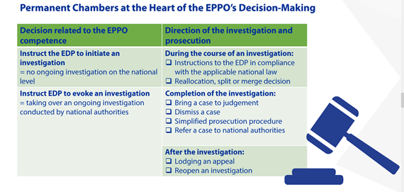
Main powers of PCs

Slide 15
PCs’ decision-making process and timing of PCs meeting
In principle the handling EDP proposes a decision to the Permanent Chamber
Deliberations during the ordinary, additional or urgent PC meetings
Voting : simply majority; each member has one vote; Chair has a casting vote; EP(S) will participating in voting, except in situations in Article 10(9) EPPO Regulation
PC Decision
365 days availability through duty chambers
Ordinary meetings: in general, 2 meetings per month
Additional and urgent meetings: depending of the necessity of the cases

Slide 16
ECP and Deputies (DECPs)
Chief Prosecutor (Article 11 (1) of the EPPO Regulation) | Deputy Prosecutors (Article 11 (2) of the EPPO Regulation)
She is the head of the EPPO, organises its work and directs its activities. She is also the President of a Permanent Chamber. She represents the EPPO externally Does not instruct EP or EDP on how to direct investigations | Assist the Chief Prosecutor in the performance of his/her duties Replace the Chief Prosecutor when he/she is absent or unable to perform his/her duties

Slide 17
European Prosecutors (EPs)
Article 12 EPPO Regulation
(1) | Supervision of cases in their Member States
(1) and [2] | Temporary replacement due to temporary absence from their duties (decision of the Chief Prosecutor)
(2) | Reallocation of the case due to excessive workload or conflict of interest (decision of the Chief Prosecutor)
(1) and (5) | Powers: supervising investigations and prosecutions on behalf of the competent Permanent Chamber where necessary, intervention and instruction on investigations and judicial proceedings Duties: submit summaries of cases under their supervision to the Permanent Chamber of the Permanent Chamber (Article 12 (1)), probably to enable the Permanent Chamber to take decisions; where appropriate, submit proposals for decisions to be taken by the competent Permanent Chamber (Article 12 (1)); and ensure that all relevant information (on the particular case and on all other developments in his Member State of origin concerning the fair and effective functioning of the EPPO in general) is provided to the Central Office (Article 12 (5)).
(3) | Power to give instructions: Instructions are guidance on how to handle a concrete investigation or prosecution in general, what investigative strategies or means of persecution should be implemented, and how to implement them. In any case, the supervising European Prosecutor cannot de facto recruit the investigations, but may do so de jure only under the conditions and in accordance with the strict procedures referred to in Article 28(4). developed in Article 28(4) (seriousness of the offence, in particular in view of its possible repercussions at Union level; where the investigation concerns officials or other servants of the Union or members of the institutions of the Union). Instructions should only be given in a specific case.
(4) | Internal review of certain acts within the bodies of the National Prosecutor’s Office

Slide 18
European Prosecutors (EPs)
Other duties and powers of the European Prosecutors, which are contained in the Regulation outside Article 12, include:
Article 10 (7) and (9) (decision-making powers in certain cases delegated by the Permanent Chamber and participation in the deliberations of that chamber);
Article 11(3) (representing the EPPO if the European Chief Prosecutor delegates this task to a European Prosecutor);
Article 13(3) (consultation of the competent national prosecution authorities and proposed to the Permanent Chamber for the reallocation of the case if the European Delegated Prosecutor is unable to carry out his/her duties);
Article 28 (3) and (4) (proposed to the competent Permanent Chamber to reassign the case to another European Delegated Prosecutor or to conduct the investigations personally in exceptional cases);
Article 31(6) (action on cross-border investigations).
As clarified by recital 28:
“The European Prosecutors should in principle scrutinise, on behalf of the competent Permanent Chamber, the investigations and prosecutions handled by the European Delegated Prosecutors in their Member State of origin.
They should liaise between the central office and the decentralised level in their Member States, facilitating the functioning of the EPPO as a single office.’
The EPs as officials of the EPPO should not act as representatives of their Member States of origin, but rather as agents of an independent EPPO acting as an indivisible body of the Union (Article 8(1)).

Slide 19
European Delegated Prosecutors (EDPs)
Article 13 EPPO Regulation
(1) | Applicable law: a European Delegated Prosecutor draws directly from the EPPO Regulation as a source of legislation and, as a secondary source, from his or her national law. The European Delegated Prosecutors shall have the same powers as national prosecutors with regard to investigations, prosecutions and indictment.
(1) | functional competence of the European Delegated Prosecutors.
(2) | EDP per Member State: at least 2 The exact number (two or more) of European Delegated Prosecutors and their European/national tasks must be approved by the European Chief Prosecutor after consulting and reaching an agreement with the competent authorities of each Member State. The total number of European Delegated Prosecutors in a Member State may be amended with the approval of the European Chief Prosecutor, within the limits of the annual budget line of the EPPO.
(3) | Article 22(1) CoEEDPs “A European Delegated Prosecutor may continue to exercise functions as national prosecutor in accordance with Article 13(3) of the EPPO Regulation only if this is permitted under the agreement reached, according to Article 13(2) of the EPPO Regulation, between the European Chief Prosecutor and the relevant authority of the Member State of the respective European Delegated Prosecutor.”

Slide 20
European Delegated Prosecutors (EDPs)
Competence of EDPs
investigations and prosecutions of the EPPO should be conducted by the European Delegated Prosecutors in the Member States (i) where they have started by themselves and (ii) in case they have been attributed to them by the PCs
Powers and duties:
Article 16(7) (replace a European Prosecutor)
Article 26(1) (launch an investigation and record it in the case management system)
Article 27(6) (right of evocation)
Article 28(1) (execution of investigative measures and other measures on their own or on instructions from the competent authorities of their Member State);
Article 30(1) (right to order or request investigative measures);
Articles 31 (cross-border investigations);
Article 33(1) (order or request the arrest or pre-trial detention of the suspect or accused person)
Article 35(1) (submission of a report containing the summary of the investigation and the draft decision whether to prosecute before a national court or to consider a referral of the case, the dismissal or a simplified criminal procedure in accordance with Articles 34, 39 or 40);
Article 36 (prosecution before national courts).

Slide 21
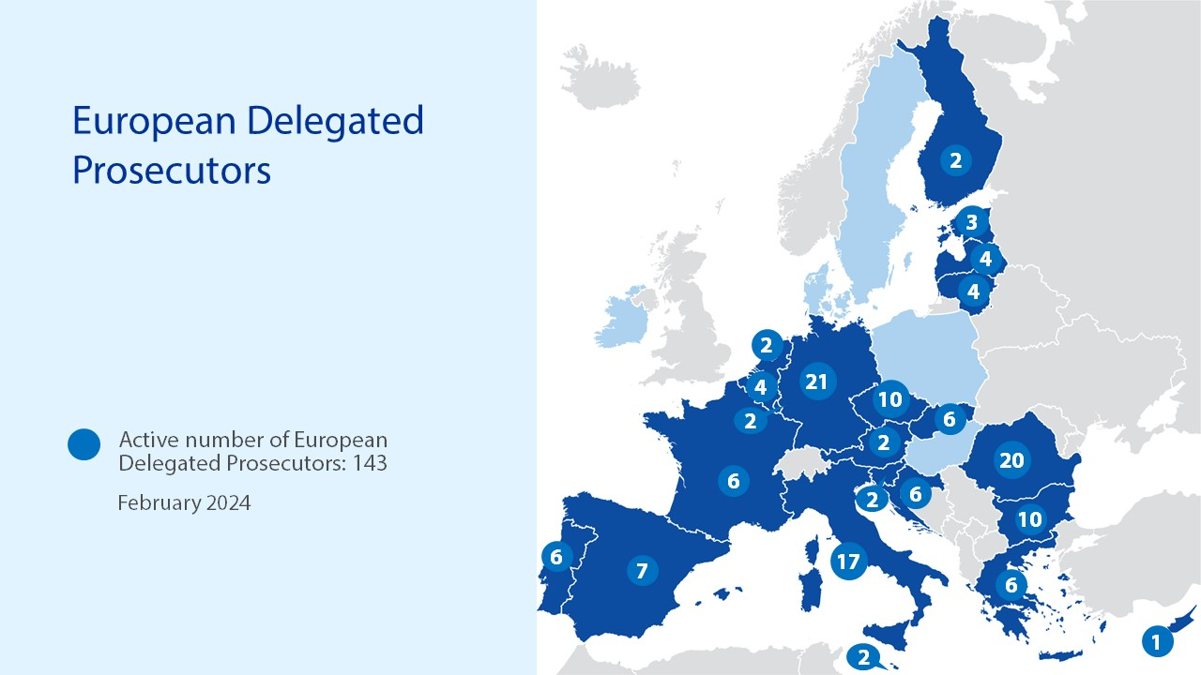

Slide 22
THANK YOU

